Slide 1
Partizzle
MERN Stack

Slide 2

Team
AMANDEEP SINGH (Leader)
RITIK BHATNAGAR
LAKSHAY MUKHIJA

Slide 3

Technology Used
HTML
CSS
VANILLA JAVASCRIPT
BOOTSTRAP
REACT JS
NODE JS
MONGOBD

Slide 4

Minimum Requirements
SCREEN SIZE ABOVE 250PX WIDTH
ANY OPERATING SYSTEM
ANY DEVICE WITH WEB BROWSER (CHROME RECOMMENDED)
INTERNET CONNECTION

Slide 5
Modules
Home
Login
Signup
Drinks
Food
Decoration
Theme
Cart

Slide 6
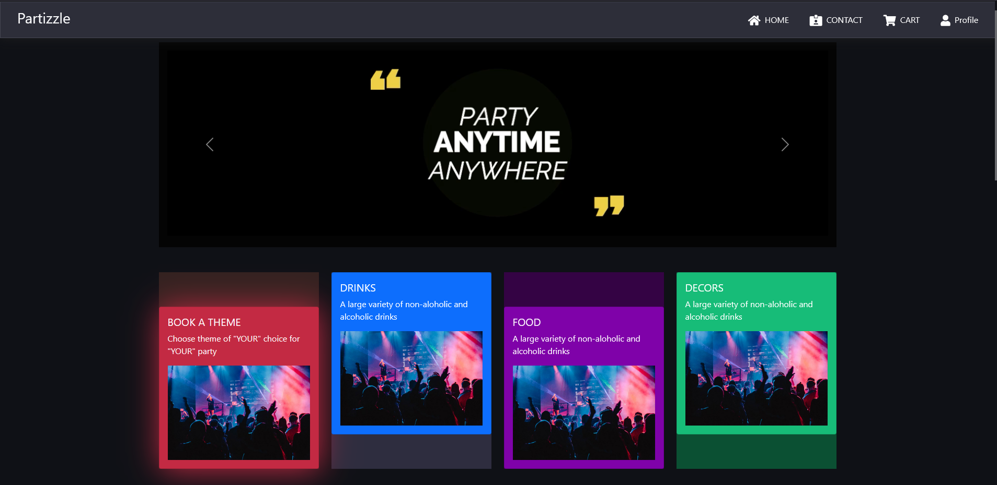
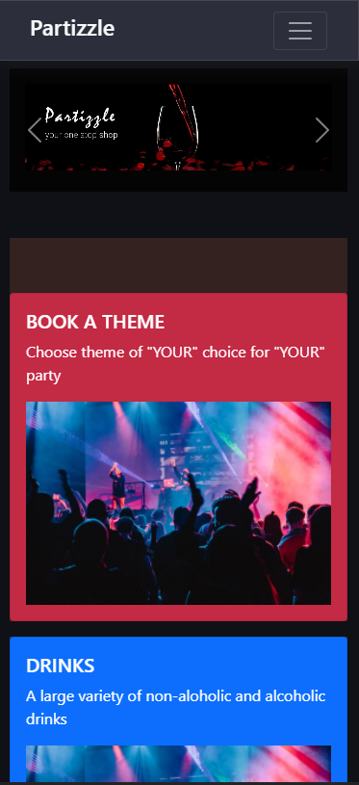
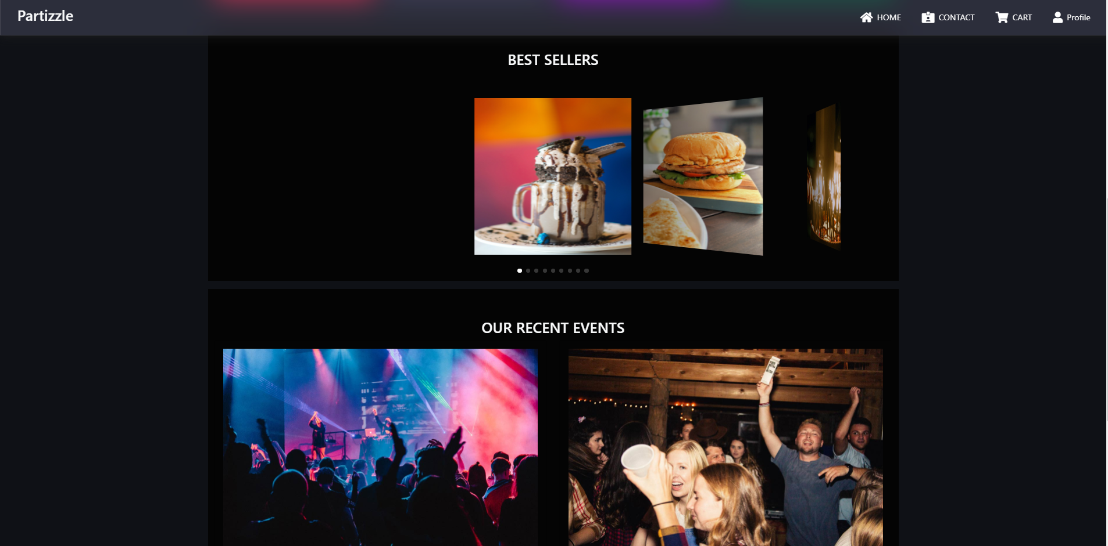
Screenshots

Slide 7
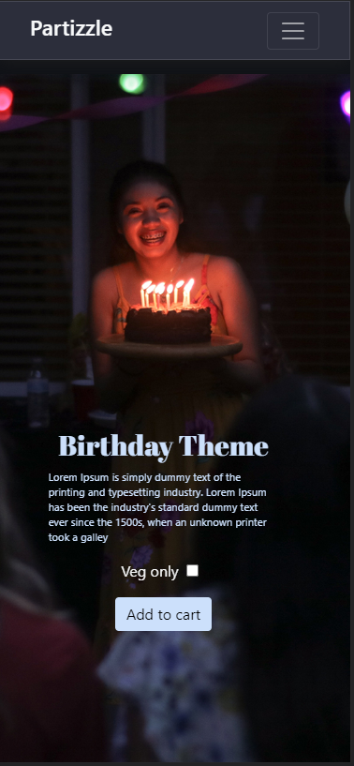
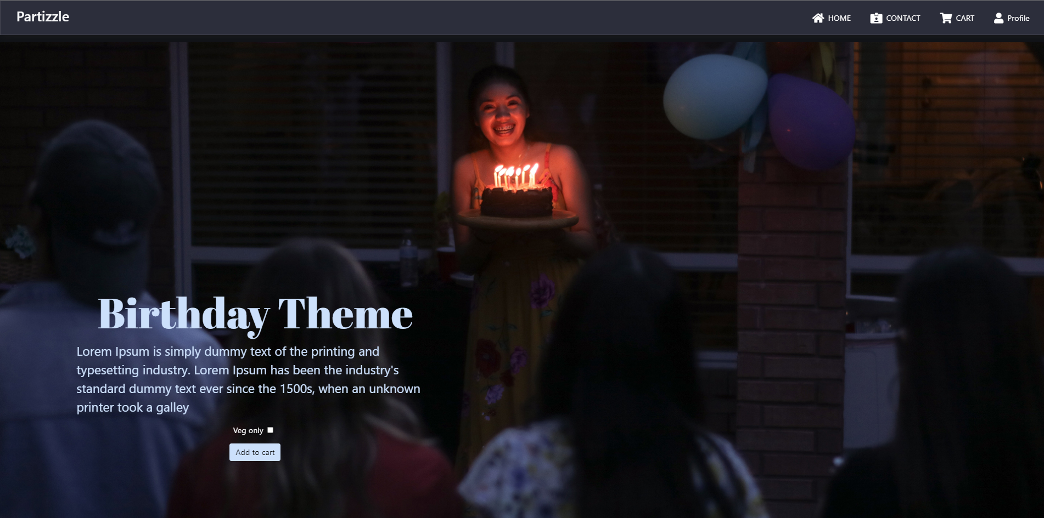
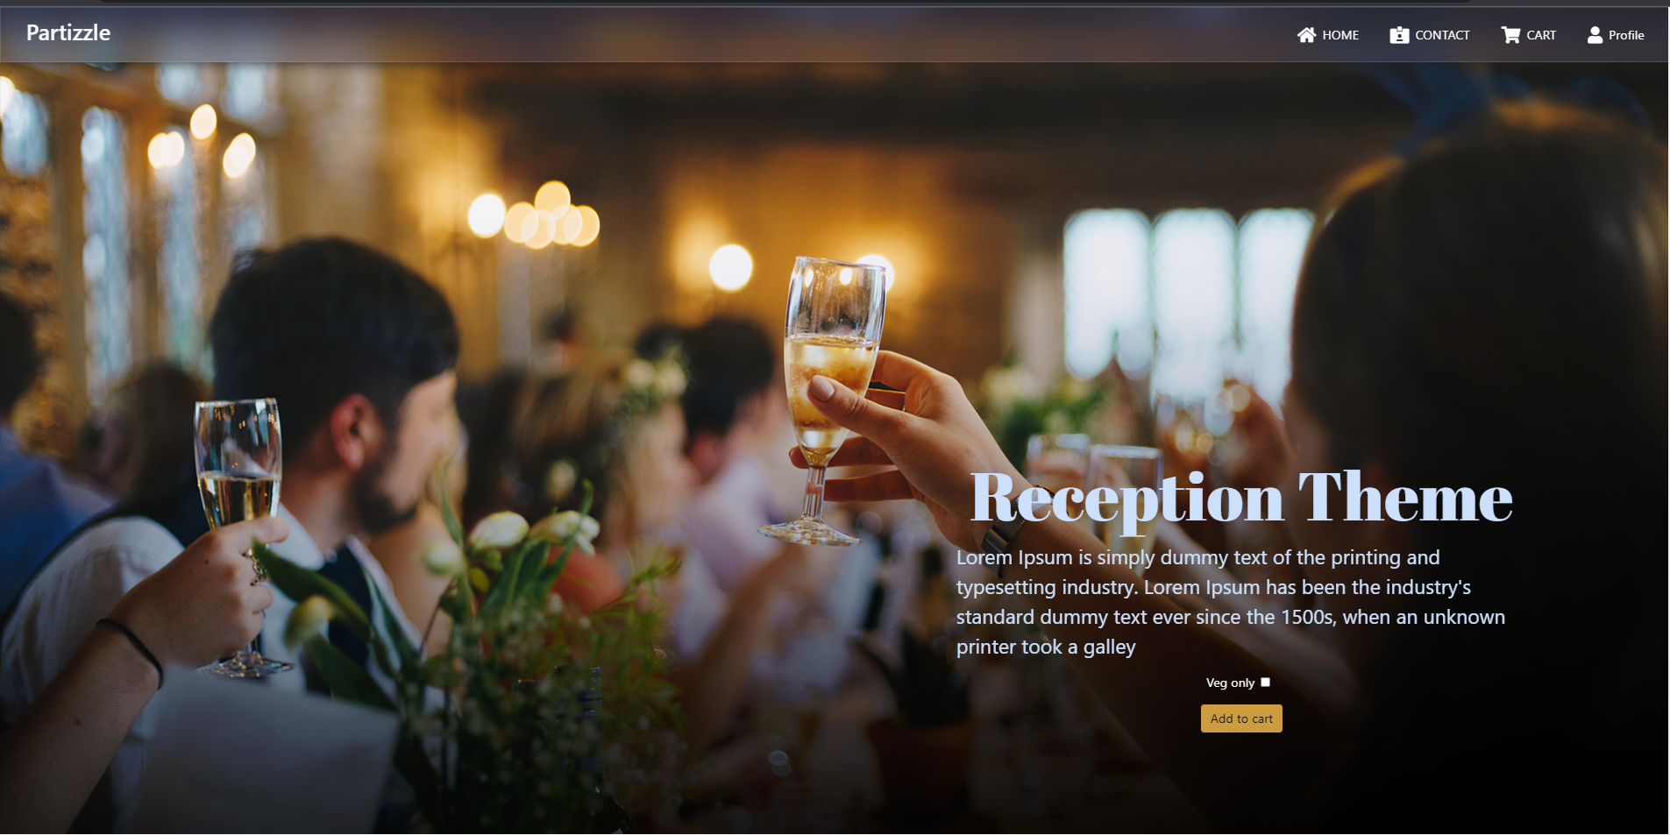

Slide 8
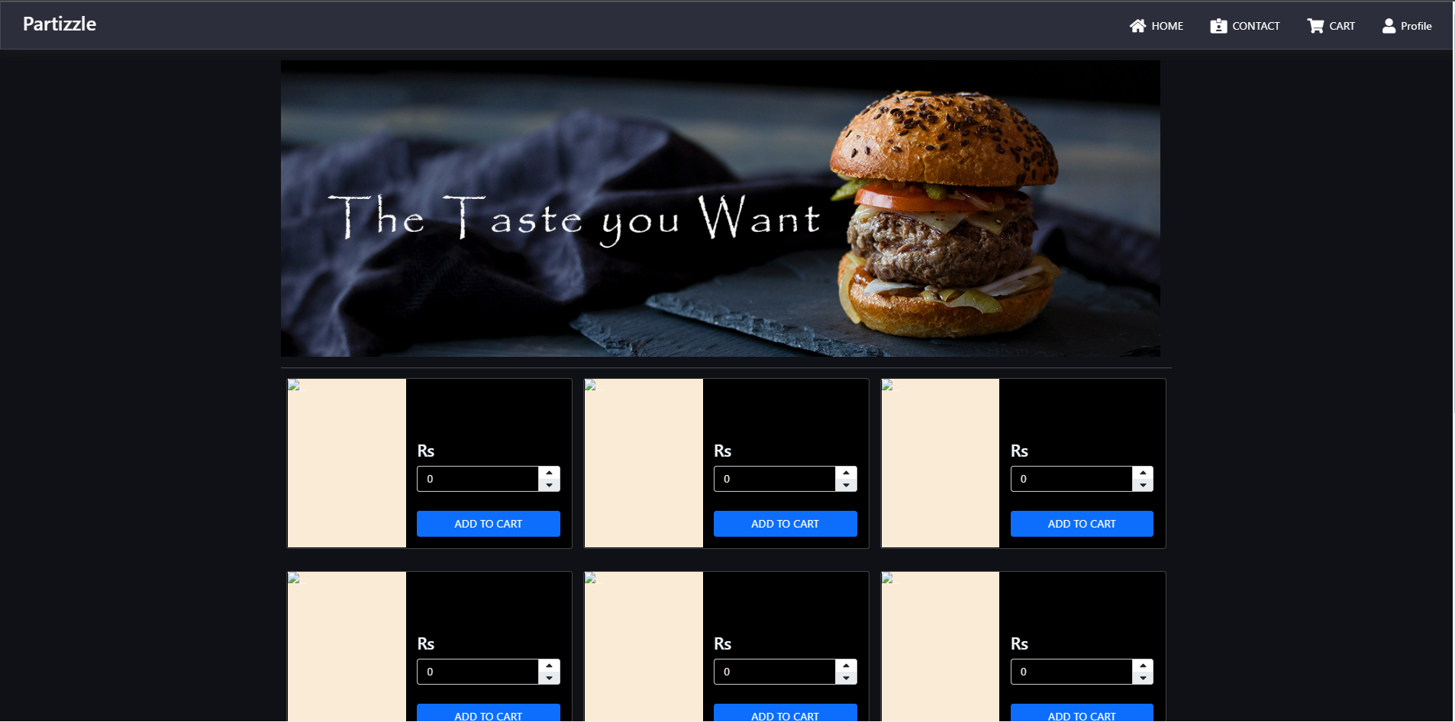
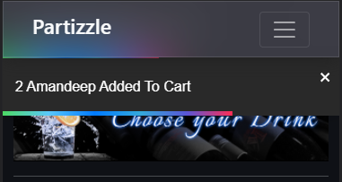
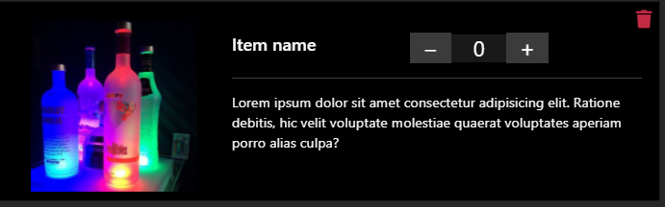
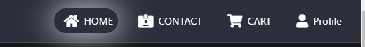
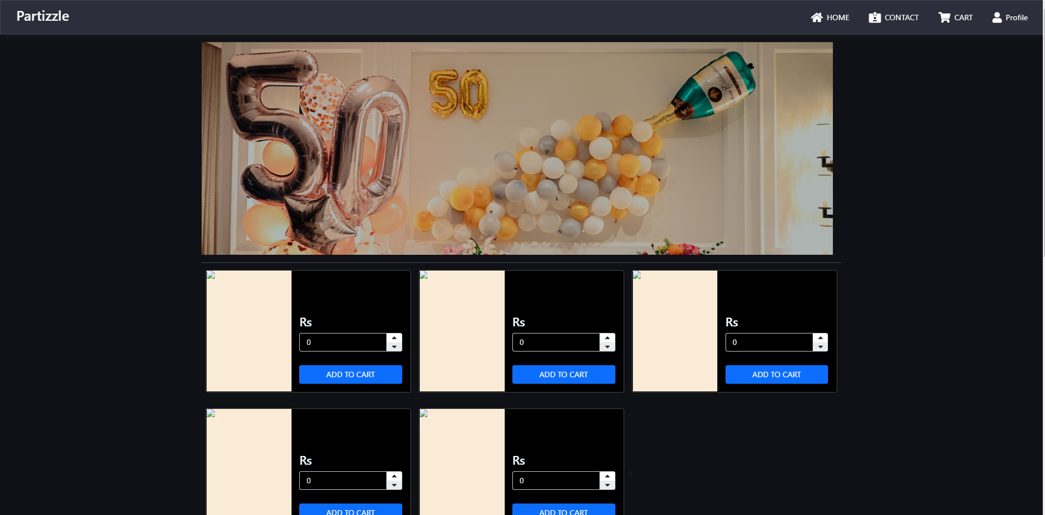
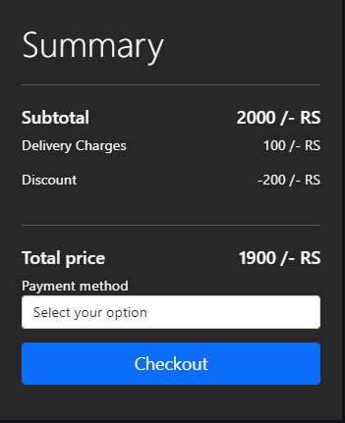

Slide 9
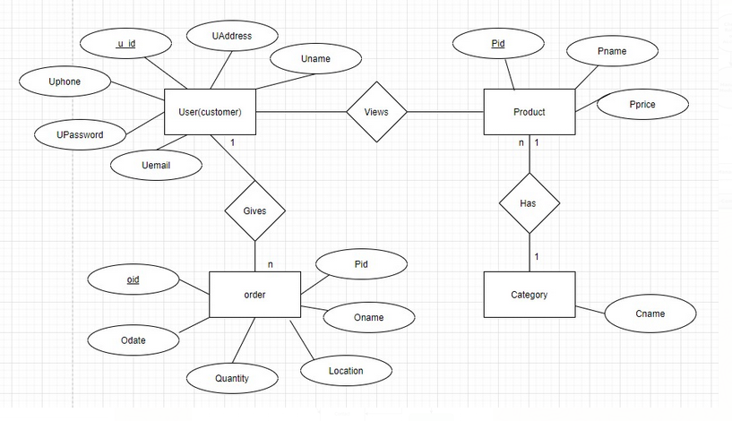
ER-Diagram

Slide 10
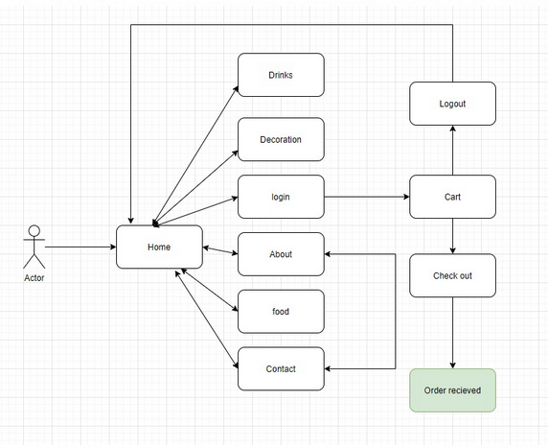
DFD

Slide 11
THANK YOU

